Slide 1
Hindi-OCR
Project Report By-
Piyush Singh(1601CS30)
Abhishek Nautiyal(1601CS02)

Slide 2
OBJECTIVE
Converting the image of a machine printed Hindi document into a editable format.

Slide 3


Intro
In today’s age of Artificial Intelligence, one of the biggest challenges in it is to identify documents in both printed as well as hand-written formats.
Unexpected This project holds great significance since it aims to assist in easing the conversion from physical to electronic type.
Emotional This data can be used anywhere, in any field, like database, data analysis, etc.

Slide 4
Key Innovation
As we know that recognition of character is not an easy task. Due to various font sizes and writing style it is difficult to recognize the character. Also in Devnagari script, many characters have similar shape, which creates trouble in recognition.
In Hindi a large number of characters can be formed using existing characters and thus increasing the difficult several folds.

Slide 5
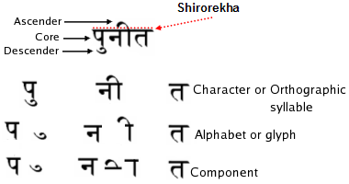
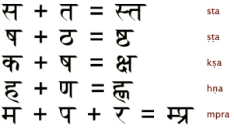
Also unlike alphabets in English, Hindi characters consists of three different layers as listed above.

Slide 6
Process
The main steps involved in Character Recognition are as follows :
Text Digitization
Gray Tone to Two Tone Conversion
Noise clearing
Text Block Identification
Skew Correction
Line and Word Detection

Slide 7
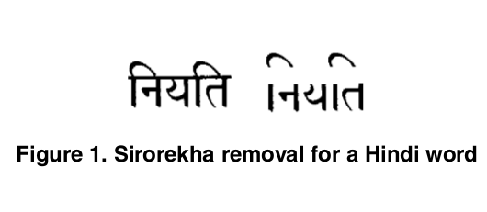
Segmentation
Hindi words can further be splitted to individual character for classification and recognition by removing Shirorekha (header line). The Shirorekha is removed by applying line detection using Hough Transform method.Various vowel modifiers can be separated for structural feature extractions.

Slide 8
Feature Detection & Classification
In this case, we will be going to apply the HOG image descriptor and a Linear Support Vector Machine (SVM) to learn the representation of characters.For this system, we
used python, openCV and sklearn to run classification and read the dataset.

Slide 9
In this classification, we will have two (2) file which is classify.py for classification and predict.py for testing the classification. In the generate Classifier.py we will perform three (3) step such as:
• Calculate the HOG features for each sample in the database.
• Train a multi-class linear SVM with the HOG features of each sample along with the corresponding label.
• Save classifier in a file.
Computing the HOG descriptor is handled by the hog method of the feature sub-
package of scikit-image. We pass in the number of orientations, pixels per cell, cells per block, and whether or not square-root transformation should be applied to the image prior to computing the HOG descriptor.
Now to classify a test image, we compute the HOG feature vector of the thresholded ROI(Region of Interest) by calling the describe method of the HOG descriptor. The HOG feature vector is then fed into the Linear SVC’s predict method which classifies which character the ROI is, based on the HOG feature vector.

Slide 10
How SVM works ?
SVM are a set of supervised learning methods used for classification, regression and outliers detection. In SVM, each data item will be plot as a point in n-dimensional space (n = number of feature) with the value of each feature being value of a particular coordinate. The classification is done by finding the hyperplane that differentiate the two classes.
The advantage of SVM classifier over other classifiers can be explained as follows. An Indian language OCR system generally has large number of classes and high dimensional feature vectors. Variability of characters is also very high at each occurrence. SVMs are well suited for such problems since they have excellent generalization capability. They always result in a global solution of the problem.

Slide 11
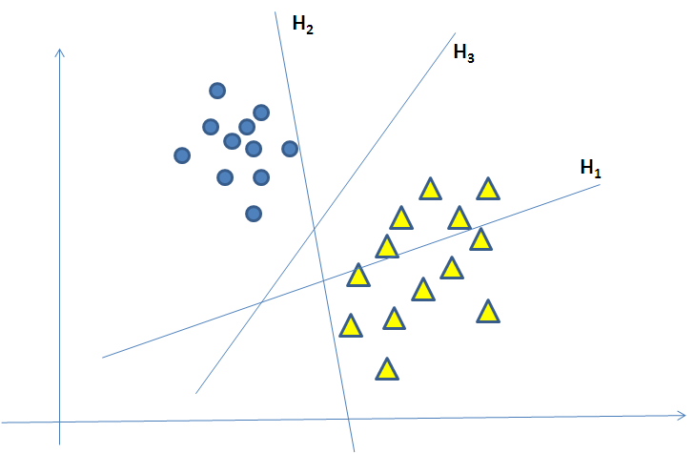
FIGURE:
Separation hyperplanes. H1 does not separate the two classes; H2 separates but with a very tiny margin between the classes and H3 separates the two classes with much better
margin than H2.

Slide 12
Results
No. of Features | 784 (corresponding to each pixel of a 28x28 images in the dataset)
No. of classes(labels) | 77
Size of Training Dataset | 30,000
SIze of Testing Dataset | 25% of Training Dataset
Accuracy | 64% (Using SVM Classifier)

Slide 13
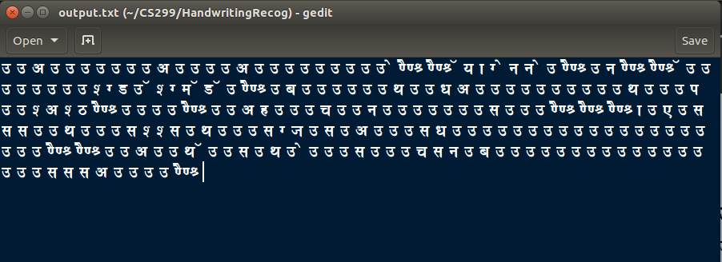
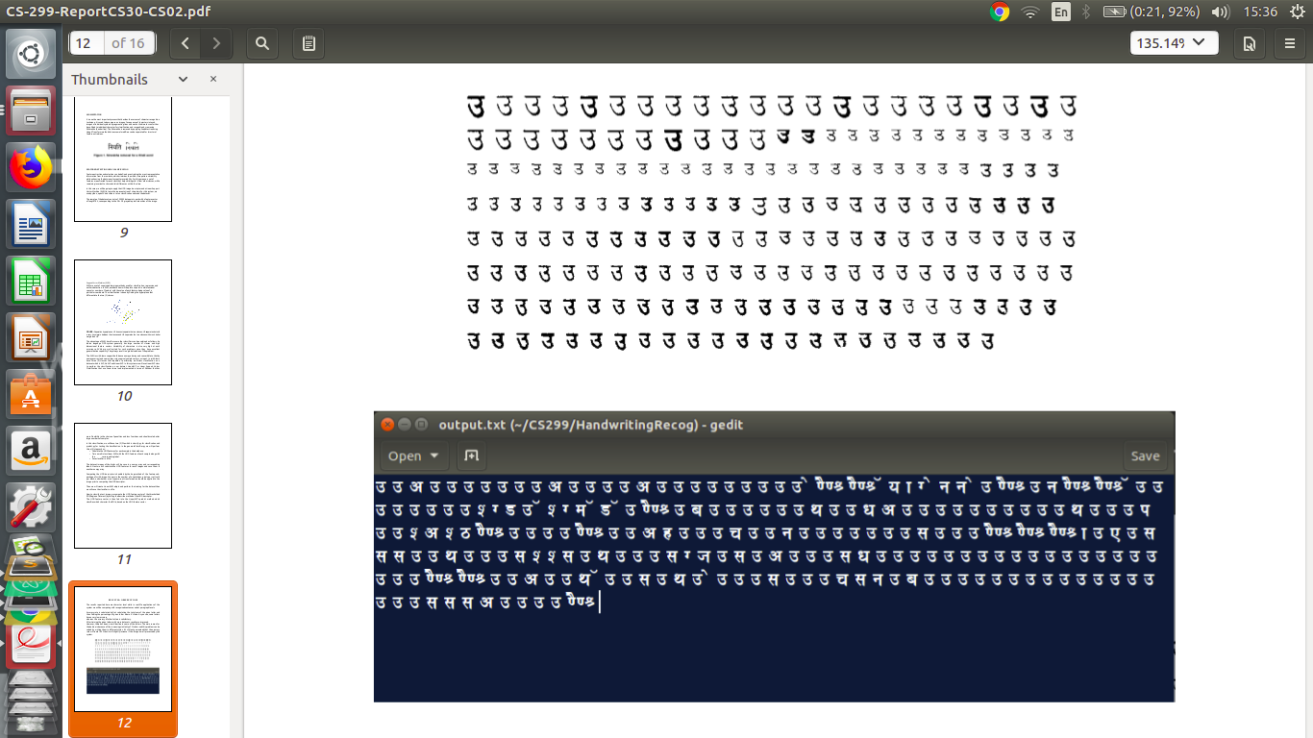
Examples
INPUT IMAGE
OUTPUT
TEXT

Slide 14
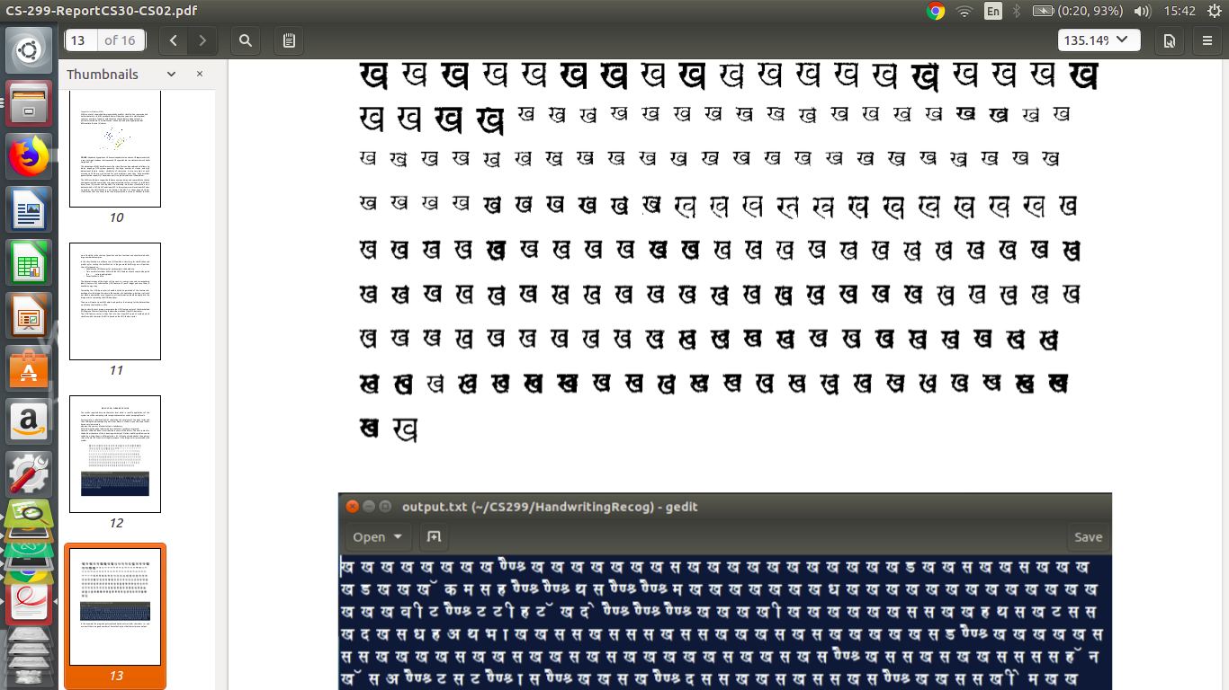

Slide 15
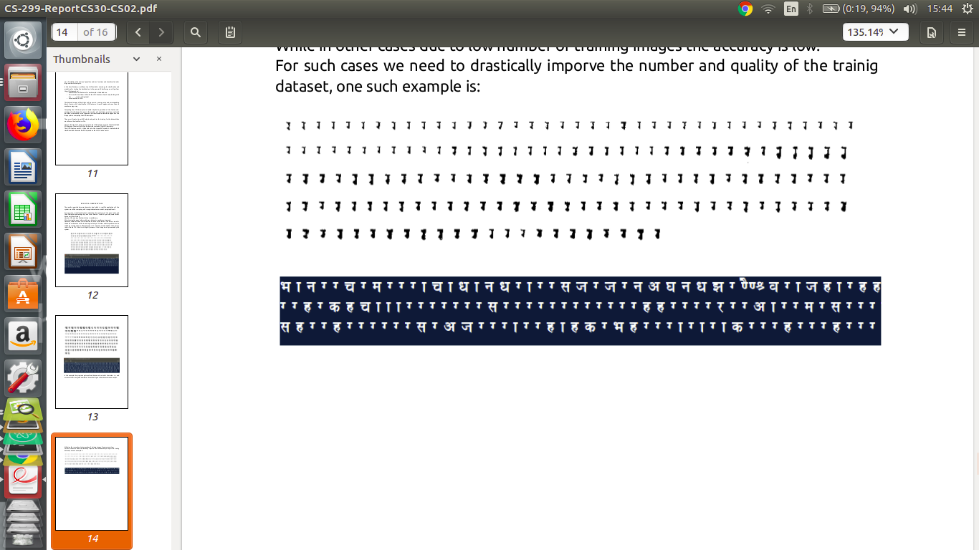

Slide 16
Conclusion And Future Work
The character segmentation method can be improved to handle larger variety of touching characters that occur often in images obtained from inferior-quality documents.
Additional work can also be completed in order to improve the outcomes and solve the problems that were confronted with by the training of a bigger set of images.
The other future enhancement that can be incorporated in the work is to use a dictionary of words to correct the output.

Slide 17


